Slide 1


ANALYSING WORLD CUP/CHAMPIONSHIP RESULTS
(Bouldering & lead climbing)
Notes:
With the lead up to the Olympics I thought it would be interesting to analyse athlete performance/host country. World cups and championships - most like the olympic format. Olympics will also involve three disciplines but I am using only bouldering and lead as speed is so different to the two and not where people get their points to win the World Cup and Championships.

Slide 2
MY PROJECT
QUESTION: Does the host country of the World Cup and World Championship series affect performance?
How to tackle it: Analyse results in each host country alongside athletes data (focus on lead & bouldering - These disciplines are where most points will be scored for the Olympics).
Sources & Tools: Webscraped data from official IFSC website (already on Kaggle). Tools include SQL, python and Tableau.

Slide 3
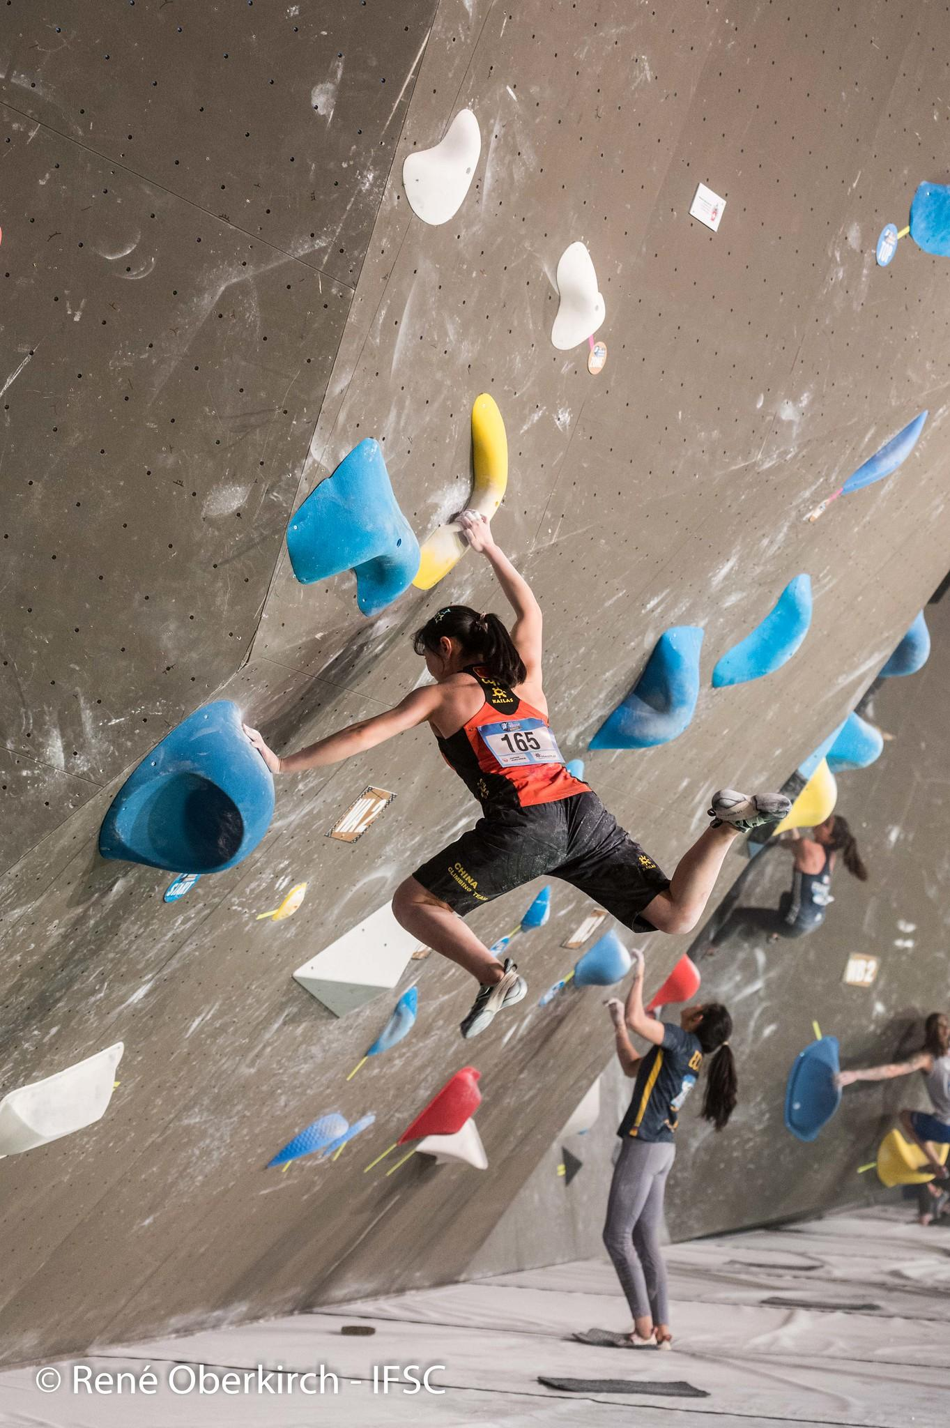

BOULDERING
Short distance without rope.
Sequence of movements (namely a “problem”).
Aim: to get to the top.
Scored: Success/ Bonus points when you make it to certain “holds” on the “problem”.

Slide 4
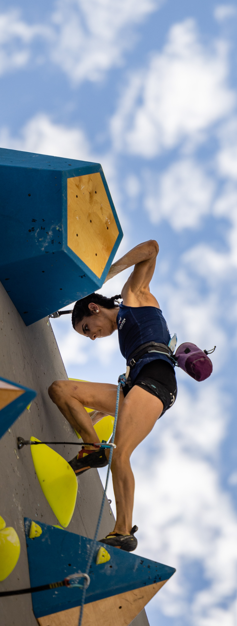

LEAD
Long distance with rope clipped in by the climber.
Sequence of movements (namely, a route).
Aim: to get to the top.
Scored by each hold you get to/aim for.

Slide 5
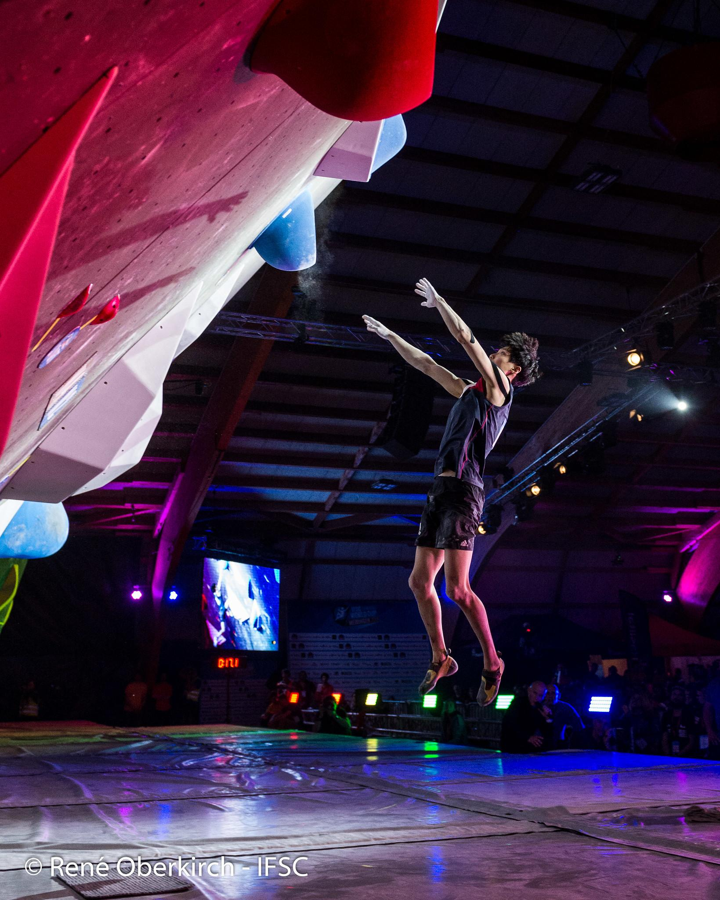
BLOCKERS
Only two years of full competition results available (e.g how many tops? How many bonus points?”).
Could only get the gender/nation/age of the climbers.
A lot of intricacies with “pre web scraped data”.

Slide 6
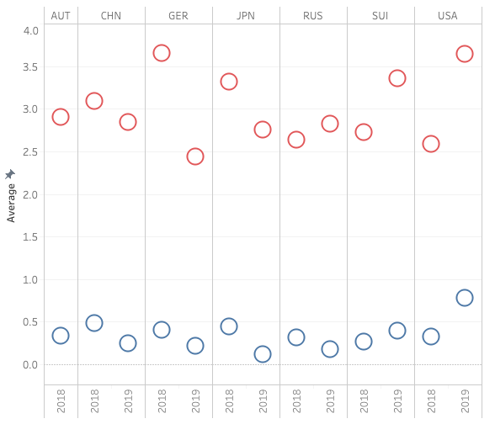
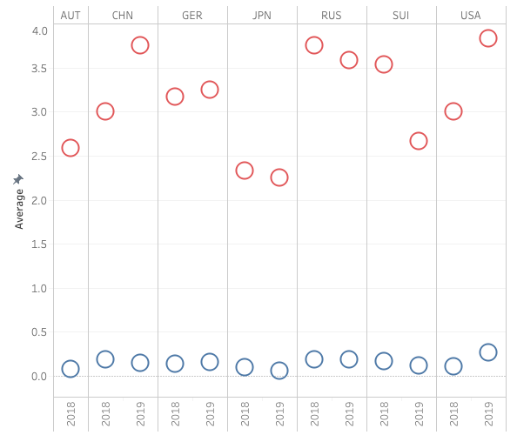

SEMIFINAL SCORES (BOULDERING)
FINAL SCORES (BOULDERING)
= TOPS
= BONUS POINTS
Notes:
Average age of climbers varied between 22-23. Gender there was quite a few unknowns so I left it out in the end. There seems to be more tops generally in 2018 than 19 which could indicate something was happening this year but it doesn’t seem to be led by what country the competition is hosted at. Generally they are all looking similar and no trend can be seen. Although, USA and Switzerland (in 2019) do look like they’ve been a bit easier especially USA. This could be down to the problems set that year.

Slide 7
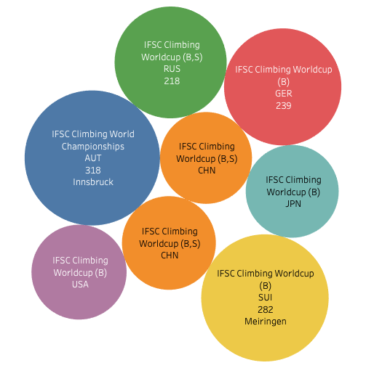
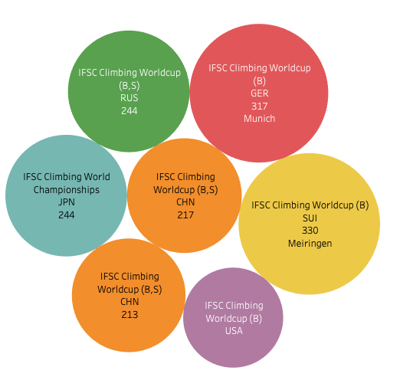
Can the country impact the athlete's performance in a different way?
2018
2019
Notes:
USA less popular of the Worldcup series, this could be what is influencing the numbers. There seems to be some fluctuation with there being more competitors overall in 2019. This could be a dependency that is influencing numbers overall. This could possibly answer to the difference in success and points in 2018 and 2019. Maybe 2018 was a training/time out year? Without more information from past competitions we couldn’t confidently state there has been a significant difference. A year before the Olympics was suppose to be, it is interesting that USA is still not popular. (Could this be money related issue?).

Slide 8
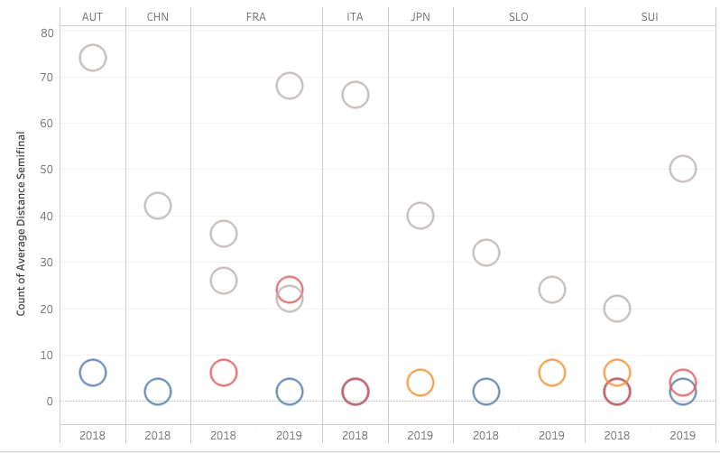
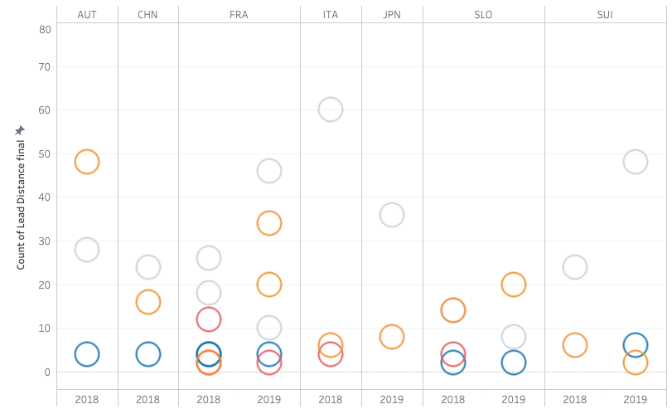




SEMIFINAL SCORES (LEAD)
FINAL SCORES (LEAD)
= TOPS
= MIDPOINT
= NEARLY TOPPED
= BEGINNING
Notes:
Average age of climbers varied between 29-26. This was sporadic throughout all competitors and distance made on the routes - Age seems unrelated once again. Easier to visualise the difficulty of the route. Nearly topped is the last panel. Grey is the middle panels and yellow is the first few panels. Japan looks hard but this is the Olympic qualifying event. Slovenia looks like its had a running of hard routes. This graph shows quite nicely that it is down to the route that affects an athletes performance. No countries look massively different except when routes appear easier (more go past the first few panels and there is high number of midpoints).

Slide 9
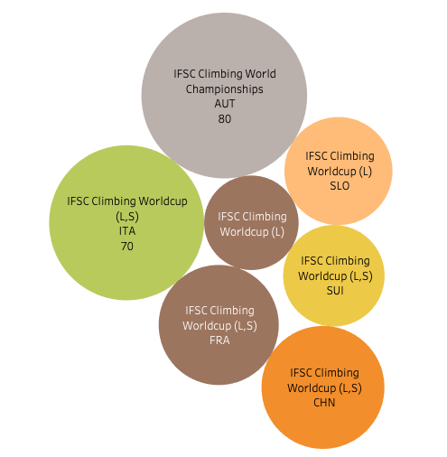
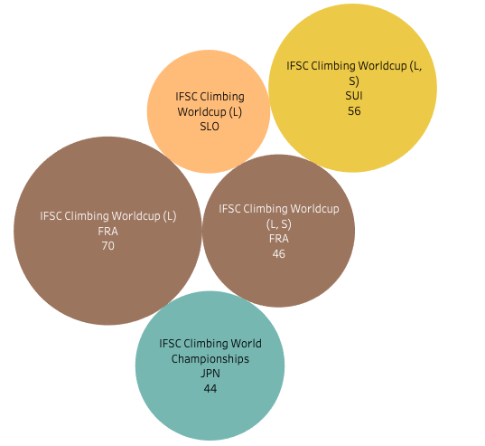
Can the country impact the athlete's performance in a different way?
2018
2018
2019
Notes:
Unlike bouldering, there doesn’t seem to really be much of an increase. It is interesting to see how focussed the lead competitions are in Europe. Lead climbing also seems less popular overall. Here it would have helped to have the heights and weights of climbers. I think it would have added more weight to whether the difference in performance was due to the route specifically. Seeing the comparison to lead climbing and bouldering made me think differently about my question. The country could impact the performance of climbers but not just due to the “route-setters”/”problem-setters”.

Slide 10
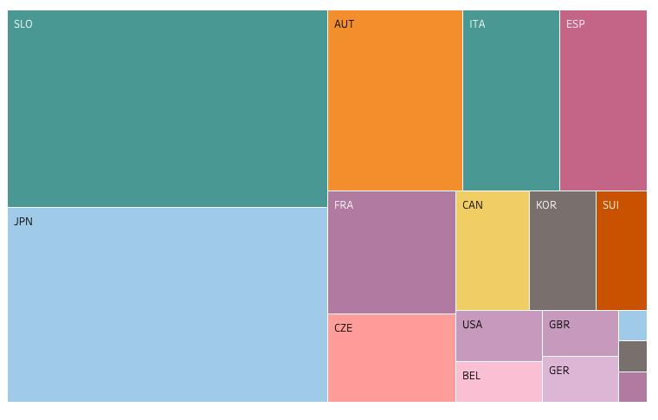
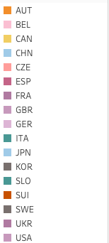
COUNTRIES REPRESENTED IN LEAD CLIMBING

Slide 11
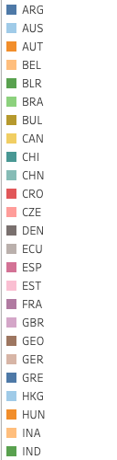
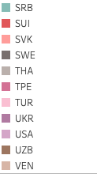
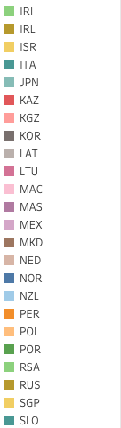
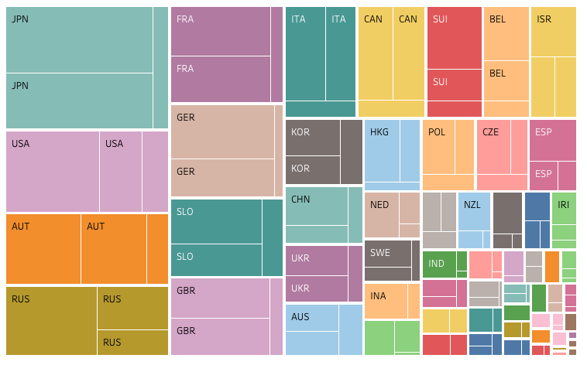
COUNTRIES REPRESENTED IN BOULDERING
Notes:
You could say country does affect performance - Is there more money invested in bouldering? If there are more competitors that definitely affects performance of athletes. Especially given it is the run up to the Olympics - Bouldering has a lot more attention. Although with my data we can’t say the host country affects performance, there is an indication that there is a disparity between lead and boulder - However, this needs more digging into.

Slide 12
CONCLUSION:
My project became more of a descriptive study. We can accept “theoretical” null hypothesis but if anything it opens up more questions. Due to the limits of my data I couldn’t go beyond this.
There is a difference in demographics and popularity between both disciplines - The country could still affect performance but we would need more data (e.g nationalist ranking & funding).
Notes:
From this sample of competition data we can’t infer that is it the host country. Especially with lead climbing it indicates it to be more based on the problem set.

Slide 13
Next Steps & Learnings
To explore whether the host country affects athlete performance - Explore nationality ranking and world cup performance for the whole World Cup and World Championships.
In terms of performance of climbers - Information is unavailable (perhaps more possible post Olympics). The data I have wasn’t “full” and could have done with more.
Webscraping data can be full of intricate errors. Be wary of this next time you use someone else's code.

Slide 14
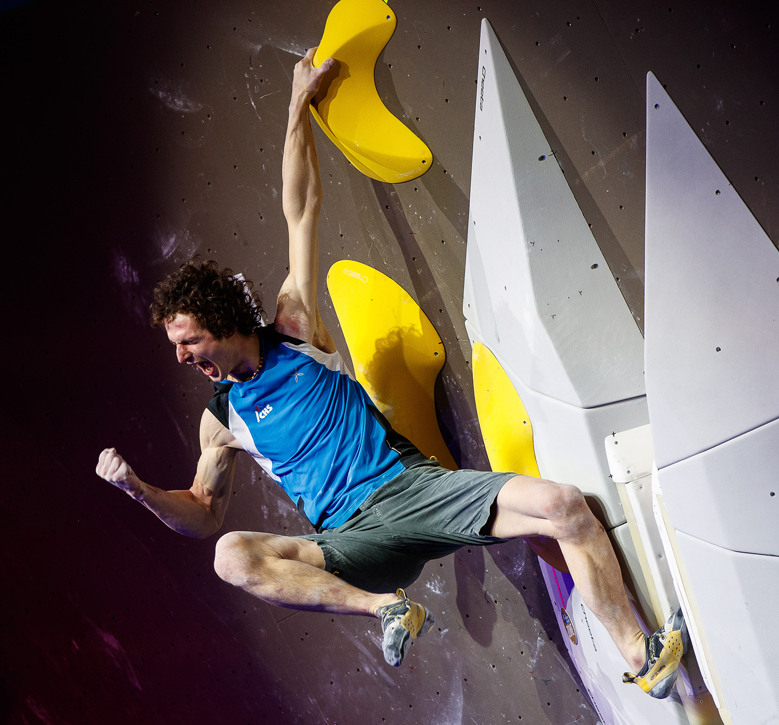
SOURCES & ACKNOWLEDGEMENTS
awKa
Brett Kurzawa thank you for providing me the data and even some ideas on how to approach it! (https://www.kaggle.com/brkurzawa/ifsc-sport-climbing-competition-results/tasks)
Antoine Bourcieu & Jim Lemmers for analysis and web scraping athlete information from the IFSC website (https://www.kaggle.com/anthonygiorgio/ifsc-climbing-competition-results-1991-2019)

